Slide 1
Window FunctionS
Subquery
DIVAKAR PRESENTATION

Slide 2
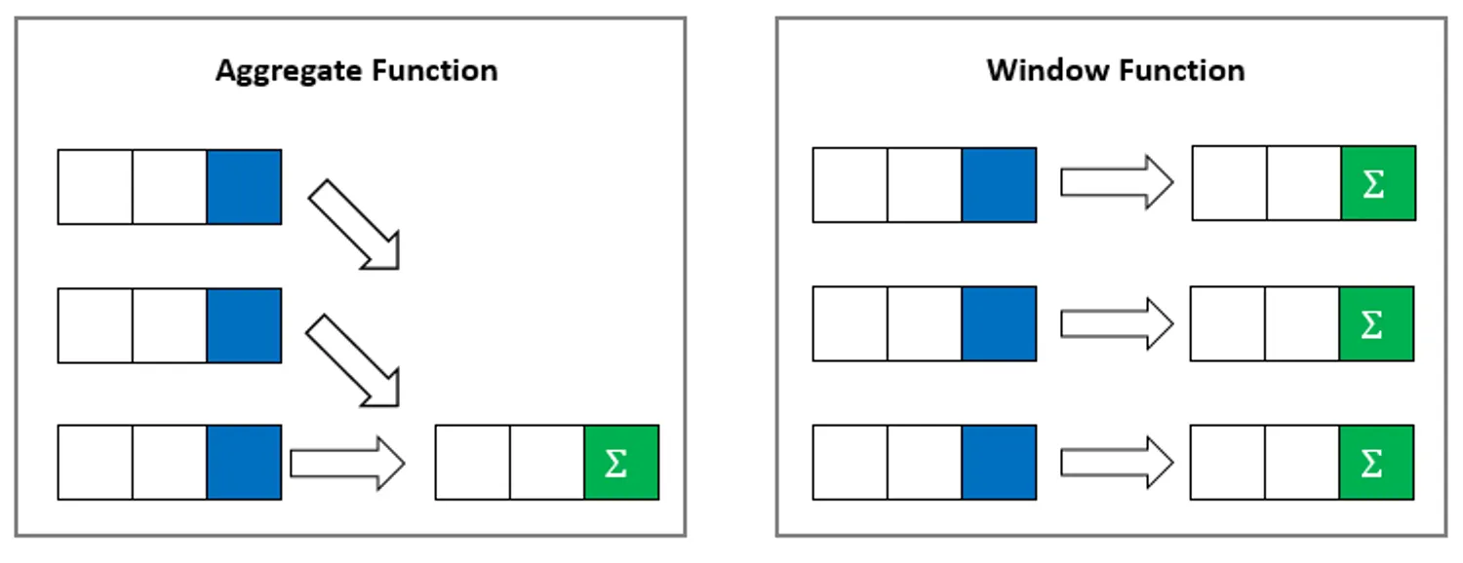
What is Window Functions?....
It allows performing calculations across a set of rows that are related to the current row, without collapsing the result into a single value.
It use values from multiple rows to produce values for each row separately.
They are commonly used for tasks like aggregates, rankings and running totals.
Aggregate functions become window functions when used with the OVER() clause.
Aggregate + OVER() = Window Function.

Slide 3

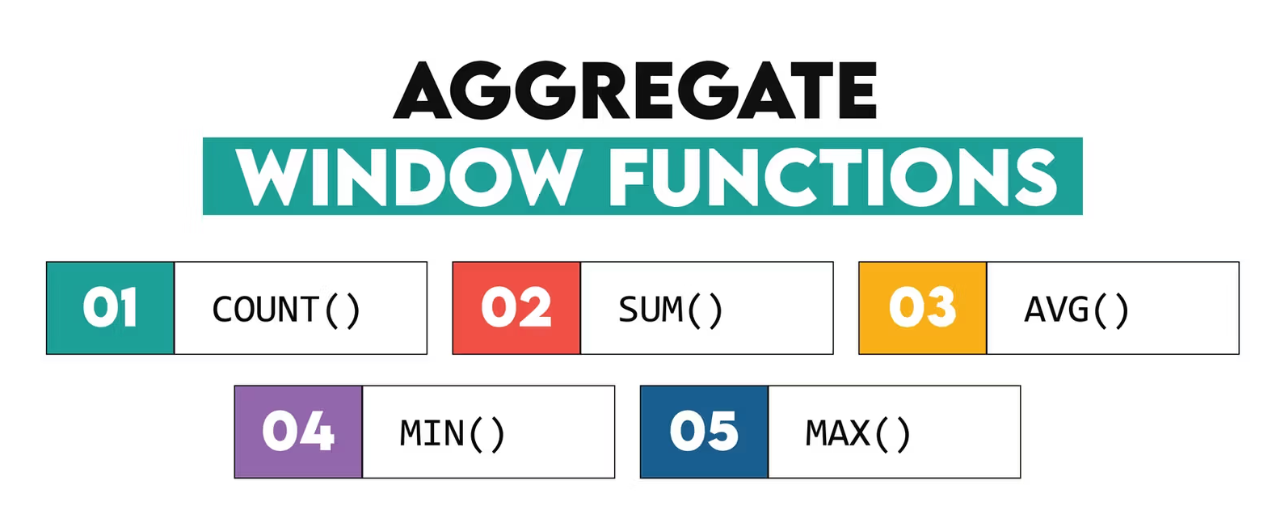
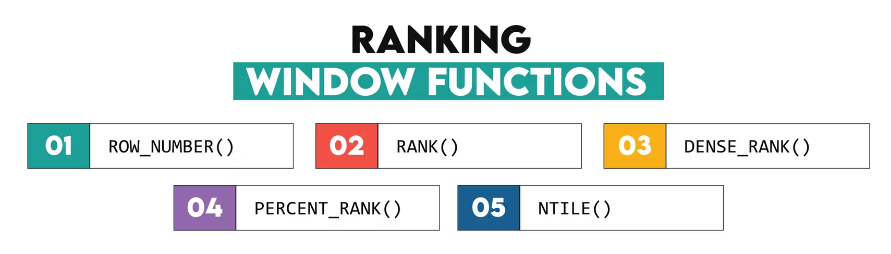
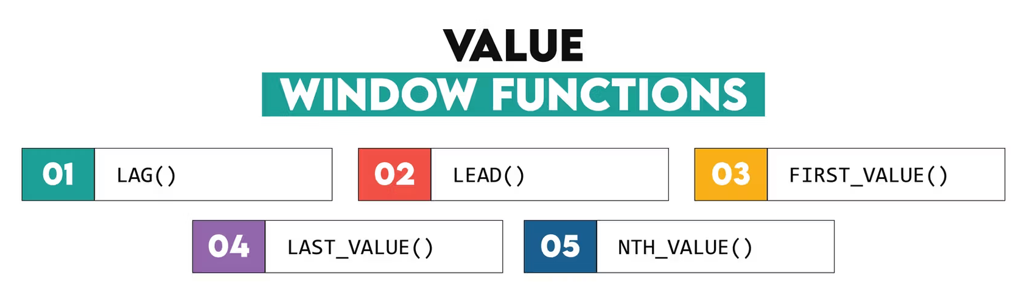
Types of Window Functions
Aggregates rows without collapsing
Assign ranks to rows
Access values from other rows.

Slide 4
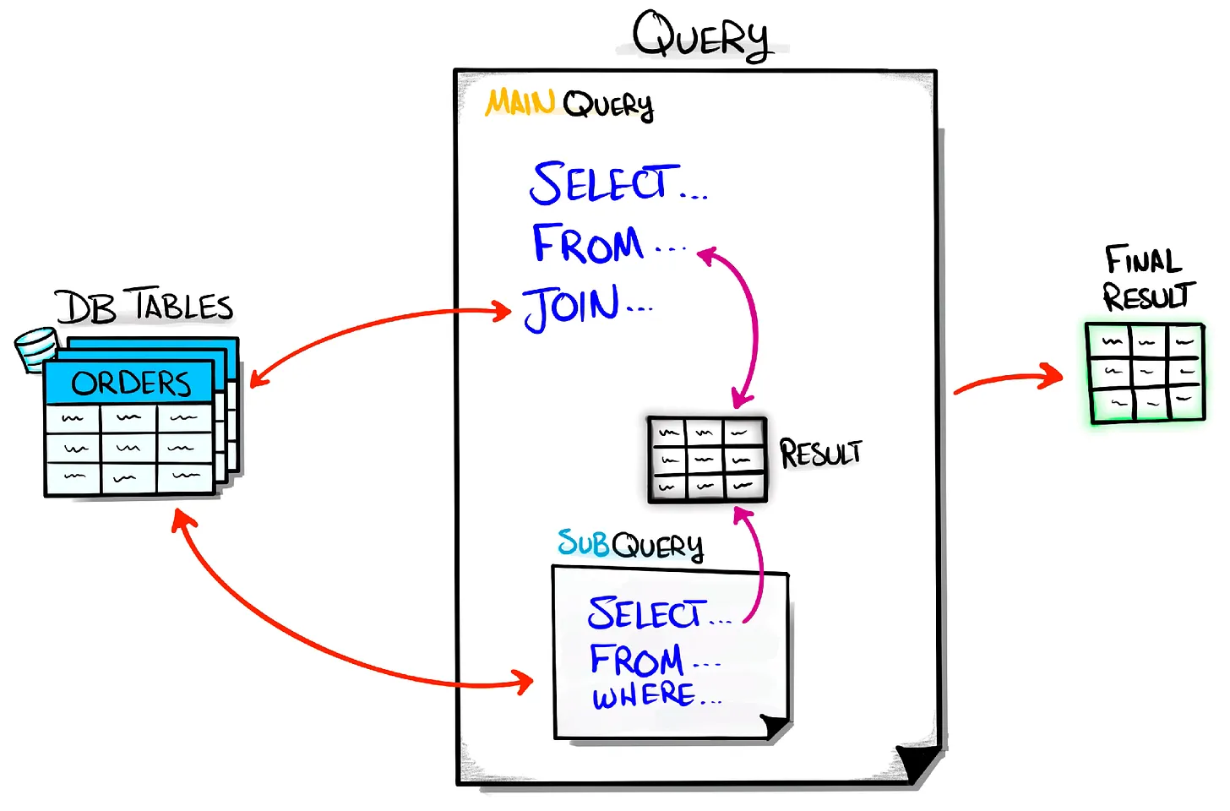
What is Subquery?....
A subquery in SQL is a query nested inside another SQL query, simple as a query inside another query
It allows complex filtering, aggregation and data manipulation by using the result of one query inside another.
Used in SELECT, FROM, WHERE, HAVING
It is a essential tool when we need to perform operations like, Filtering, Aggregating, Updating, Deleting.

Slide 5
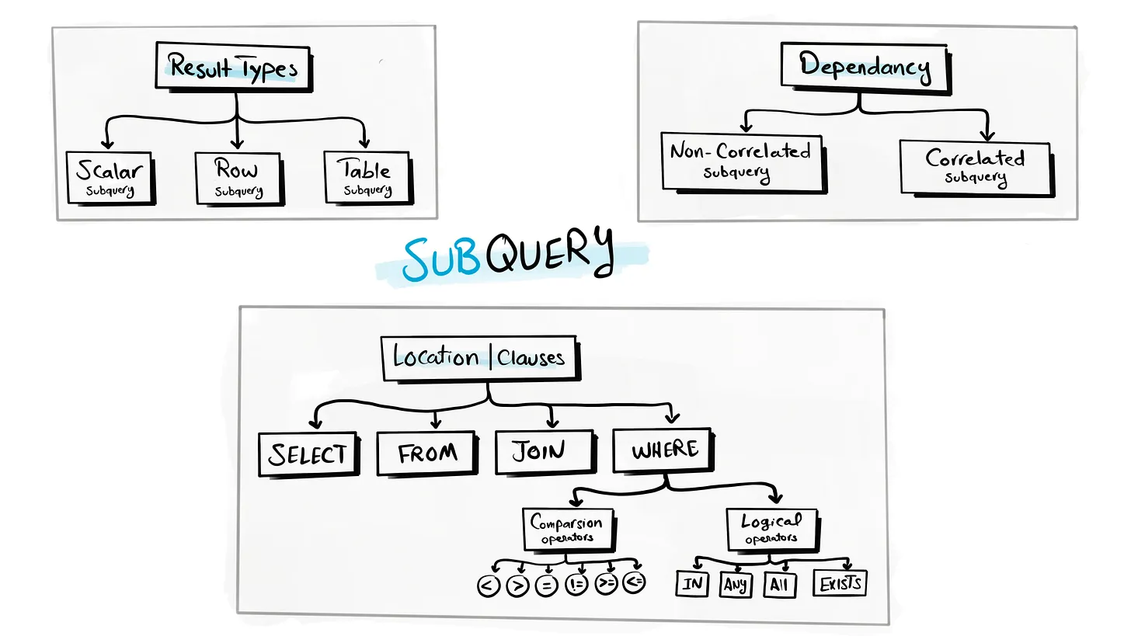
How Subquery works
Whenever we execute these subquery, at first the inner query get executed first.
Subqueries are nested inside statements like SELECT, INSERT, UPDATE, DELETE, or any other subquery.
It present in the WHERE clause, FROM clause, or HAVING clause of the PARENT SQL query.
Used with comparison operators and logical operators like >, <, >=, <>, <=, SOME, ANY, ALL, and IN.

Slide 6
01
02
03
04
Types of Subqueries
05
06
07
08
Scalar Subquery
Single-row subquery
Multiple-row subquery
Multiple-Column Subquery
Returns a single value
Returns a single row of values
Returns one or more rows
Returns one or more columns
Correlated Subquery
Non-Correlated Subquery
Table Subquery (Inline View)
Nested Subquery
References one or more columns in the outer SQL statement and is related to the outer SQL statement.
Runs independently of the outer query
Returns a result set that can be treated as a table
A subquery inside another subquery

Slide 7
Examples

Slide 8
Window Functions
ConCLUSION
Subqueries
Used in Performing calculations across a set of related rows without collapsing the result set
It is for tasks like tasks like ranking, running totals, and comparisons within groups while preserving individual row details.
Both are powerful SQL constructs for data manipulation
A query nested within other queries.
It is for tasks like complex filtering, aggregation and data manipulation by using the result of one query inside another.

Slide 9
Thanks

